Slide 1


CareBridge Hospital Hospital Management System
Programming 1 Project!!

Slide 2
Group Information & Work Distribution:
Members:
Tea Yu Jie – *LEADER* - Part 3
Cheng Feng - *NOBLE* - Part 1
Yu Luan - *COMMONER* - Part 2
Quenton - *SLAVE* - Part 4 – IP: 169.254.169.254

Slide 3

Work Contribution:
Tea Yu Jie: 27.5% Cheng Feng: 27.5% Yu Luan:25% Quenton: 20%

Slide 4
Pseudocode – 1: Chengfeng

Slide 5
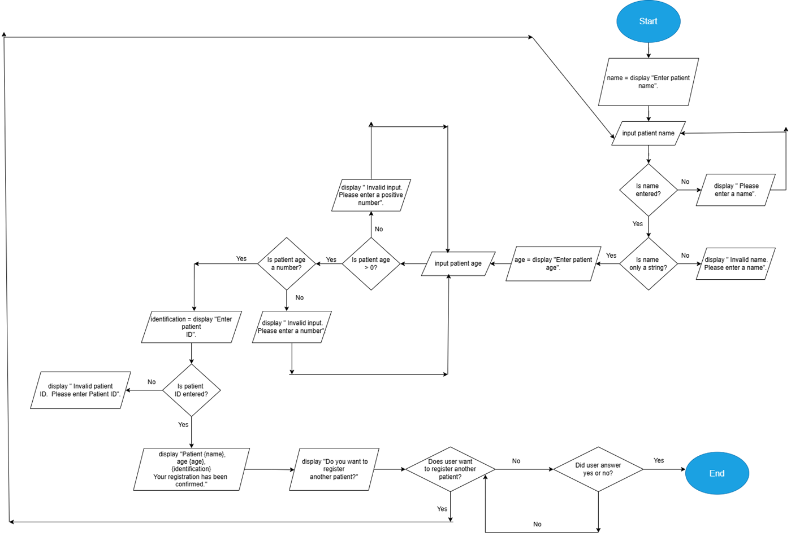
FlowChart – 1: Chengfeng

Slide 6
Pseudocode -

Slide 7
FlowChart -

Slide 8
Pseudocode -

Slide 9
FlowChart -

Slide 10
Pseudocode – 4: Quenton
SET room = "Room 2"
DISPLAY "--- Triage Summary ---"
DISPLAY "Severity Level: " + {severity}
DISPLAY "Assigned Room: " + {room}
BREAK
EXCEPT ValueError:
DISPLAY "Error: Invalid input. Please enter a number."
END FUNCTION

Slide 11
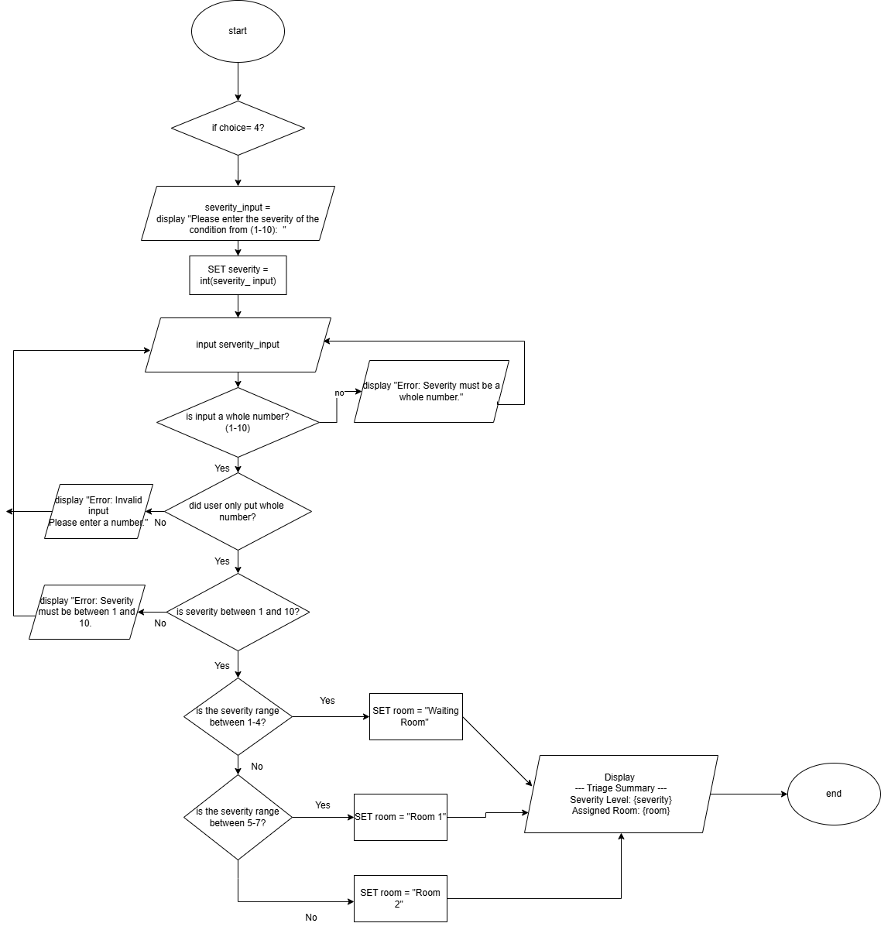
FlowChart – 4 Quenton

